Slide 1
Light and Matter
Slide Set 8.01

Slide 2
Introduction
There are many visual cues when we look at objects, helping us to understand what we are seeing.
We are concerned with the effects of lighting in this module.
We have noticed that three dimensional figures don’t look very three dimensional even with perspective used.
The problem is that we have been using very flat lighting: there is the same amount of light coming from all surfaces in all directions.

Slide 3
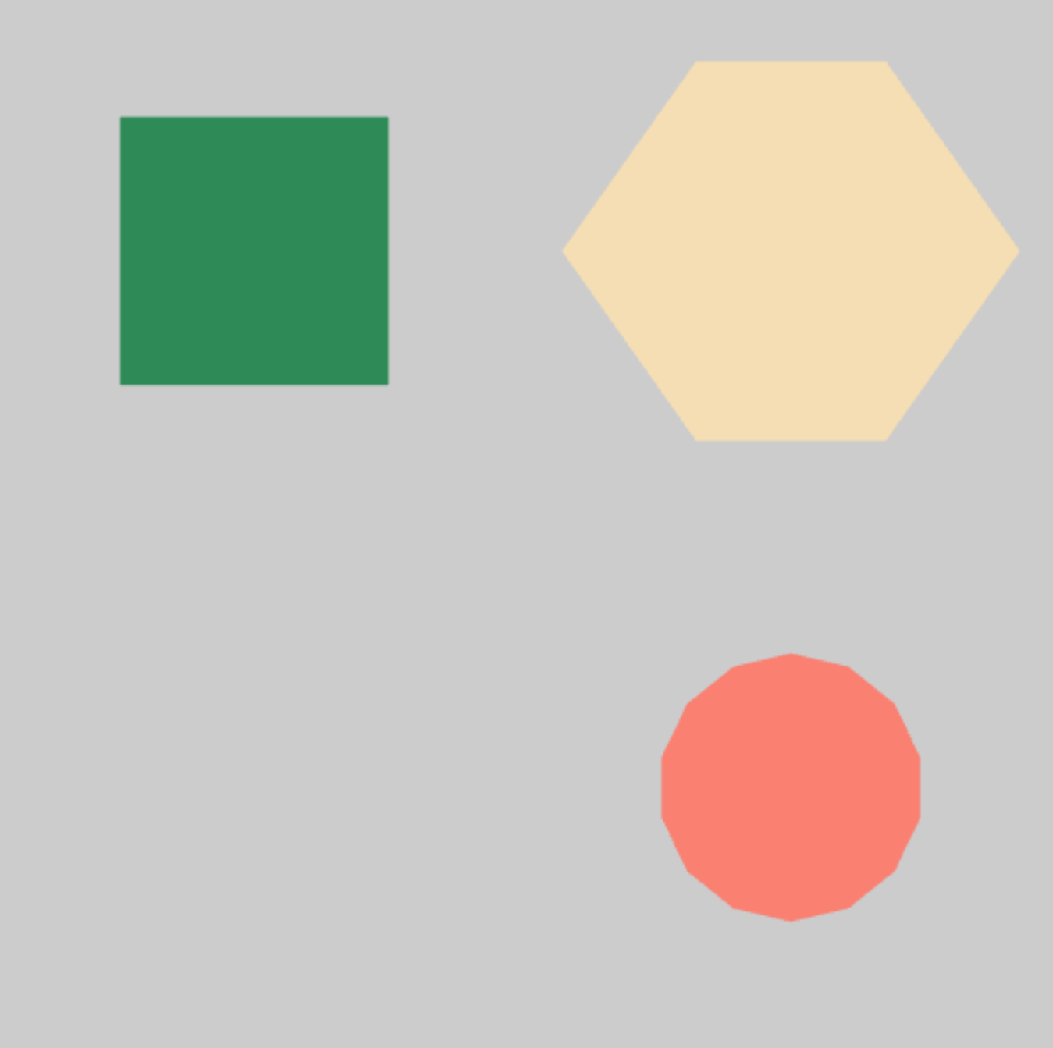
Without Shading, No Depth

Slide 4
Terminology
Shading references how the light seems to vary in intensity on different parts of the object
Shadowing references places that are darker because light is partially or fully blocked from an area

Slide 5
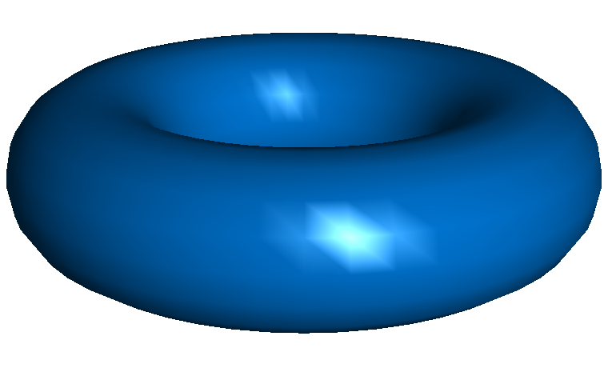
Lighting Effects: Gouraud Shading
Gouraud shading determines a color at each vertex of a triangle and interpolates that color across the triangle.

Slide 6
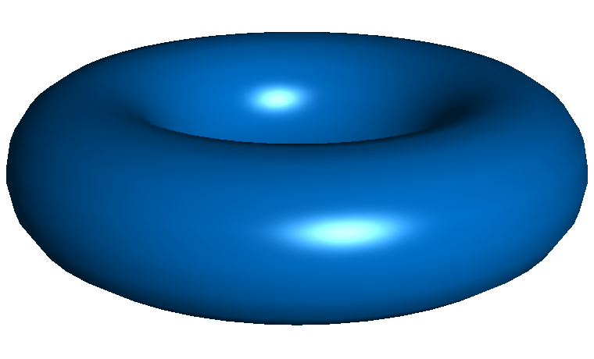
Lighting Effects: Phong Shading
Phong shading interpolates normal vectors at the triangle vertices (normals are discussed later). The color of a fragment is then determined in the fragment shader.

